Slide 1

Heading
ICT Convergence
Fast Tracking Service Delivery
Through Fixed Mobile Convergence
Sub heading
"Leading solutions for a changing world"
Notes:
This is where you want to hook your audience and tell them what is in it for them.

Slide 2


Slide 3
HISTORY……….
Lack of de-regulation
Lack of infrastructure
Pricing
Role of wireless technologies
  Mobile Health
  Education

Slide 4
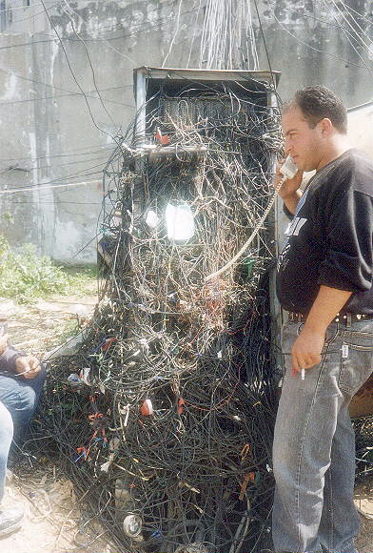

Where are
we today?

Slide 5

Mobile Growth in the World
1st Billion customers took
20 years to Connect!
        2nd Billion customers took
    3 years to connect!!!!

Slide 6









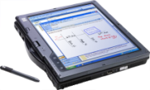






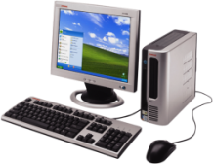
35
30
25
20
15
10
5
0
34.1%
Converged
Mobile Phones
YOY % shipping growth
18.6%
Mobile PCs
5.8%
Mobile Phones
3.9%
Desktop PCs
CAGR 2006-2010

Slide 7
What is Mobility Evolution?

Slide 8
Target Market
Notes:
8
According to information provider Thomson Reuters, South African M&A volumes rose 122 percent to $27.6 billion (R217.2bn) in the first half. Thomson Reuters said M&A volumes, in which South African companies were targeted, accounted for 73 percent of targets in African/Middle Eastern countries. This is up from 40 percent in the second half of last year.
In the year to date M&A activity in the telecoms sector has been highest, attracting 63 percent of the deals.

Slide 9

























What does the market look like today
Carriers
VANS
Consumer
Voice & Data
Data Hosting
Voice & Voip
Outsourcers
Integrators
Web Based app Providers & OTT
Mobile Operators

Slide 10
SA Converged Landscape – 3 Year view
Network Service
Providers (FMC)
2nd tier
ECNS/ECN
Outsourcers
Integrators
Web Based app Providers & OTT

Slide 11




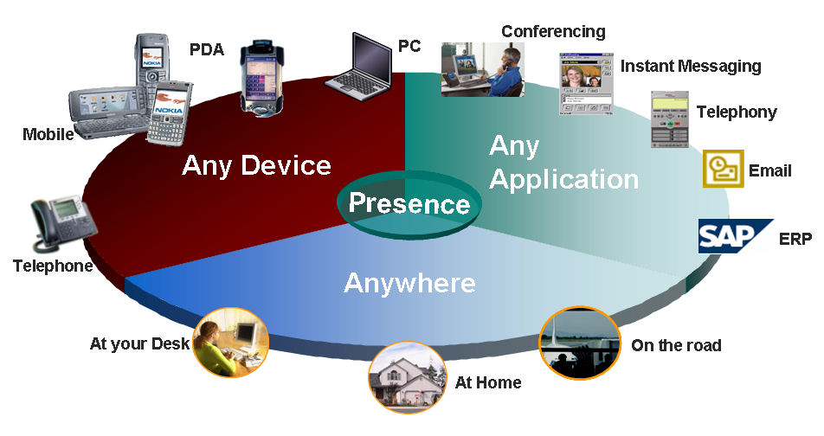




BEYOND MOBILE
PC
Conferencing
Instant
messaging
Voice
PDA
Telephony
Data
Mobile
Mobility
Appl Hosting
Email
Any device
Any application
CRM
Contact Centre
Presence
ERP
Security
Access
Telephone
Anywhere
Any Person
At your desk
On the road
At home

Slide 12


The strategy
• Expanding horizontally to compete as a provider of
  Managed Service - VANS operator
  Corporate Access - Last mile access provider
  Gated Communities Infrastructure
  Connectivity provider
  International connectivity
Continue to focus on mobile voice and data
  Democratise data
  Provide value based deals
  Continue to bridge the digital divide, empower users.
Position as an ICT partner to drive service delivery
  Health
  Education
Expand into Africa

Slide 13

The Pillars of the National ICT Strategy
APPLICATIONS LAYER
LOCAL CONTENT
E-EDUCATION
E-GOVERNMENT
ICT & ECONOMY (SMME)
E-HEALTH
ICT INDUSTRY DEV.
UNIVERSAL ACCESS AND SERVICE (ICT & SOCIETY)
FOUNDATION
HUMAN RESOURCE DEVELOPMENT (CAPACITY BUILDING)
BROADBAND INFRASTRUCTURE

Slide 14
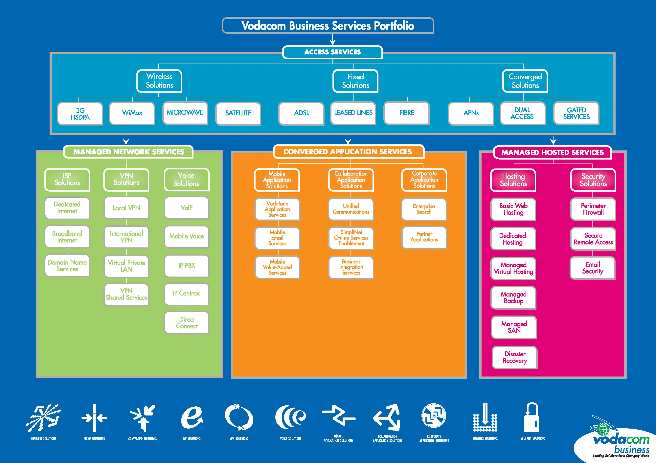
Notes:
Our four main towers of services include:
Access Services
A state-of-the-art, carrier-class, next-generation network that offers both fixed and wireless access technologies ranging from 3G and HSDPA, WiMax, Microwave, ADSL, Leased Lines and Fibre.
Managed Hosted Services
Providing customers the ability to outsource functions such as hosting, application services, storage and security functions which will be housed in our specialised, robust and fully redundant data centre
Managed Network Services
These include a range of Internet service provider solutions, virtual private network (VPN) solutions and a next-generation network that will provide communication options including traditional mobile voice and Internet based voice solutions.
Converged Application Services
Enabling customers to access any communication service or application via a range of devices, from anywhere offering true convergence.

Slide 15
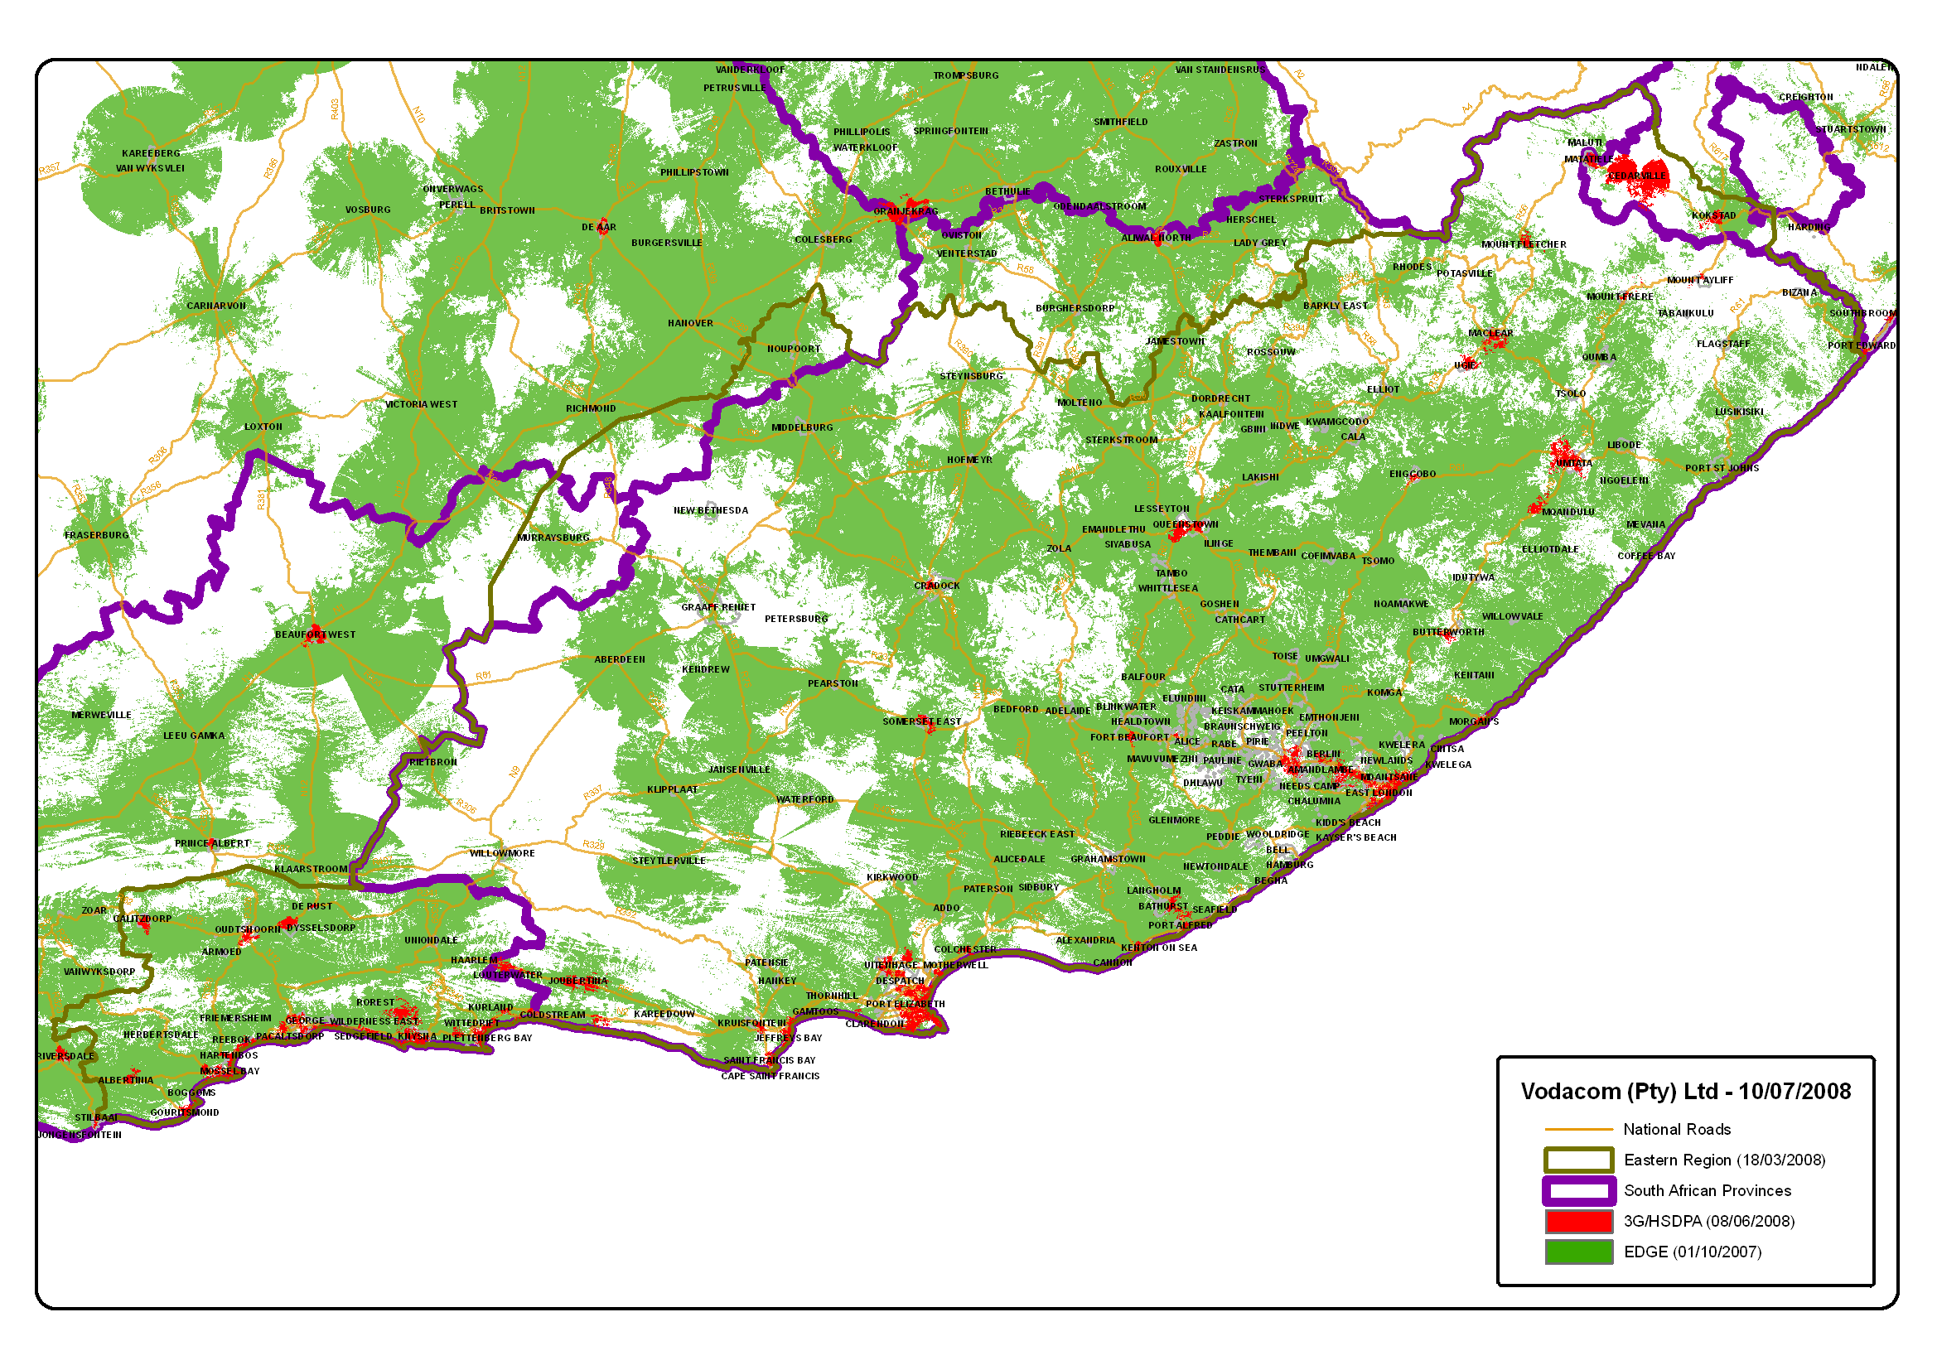
Mobile Broadband Connectivity in the Eastern
Cape

Slide 16
Notes:
Our four main towers of services include:
Access Services
A state-of-the-art, carrier-class, next-generation network that offers both fixed and wireless access technologies ranging from 3G and HSDPA, WiMax, Microwave, ADSL, Leased Lines and Fibre.
Managed Hosted Services
Providing customers the ability to outsource functions such as hosting, application services, storage and security functions which will be housed in our specialised, robust and fully redundant data centre
Managed Network Services
These include a range of Internet service provider solutions, virtual private network (VPN) solutions and a next-generation network that will provide communication options including traditional mobile voice and Internet based voice solutions.
Converged Application Services
Enabling customers to access any communication service or application via a range of devices, from anywhere offering true convergence.

Slide 17
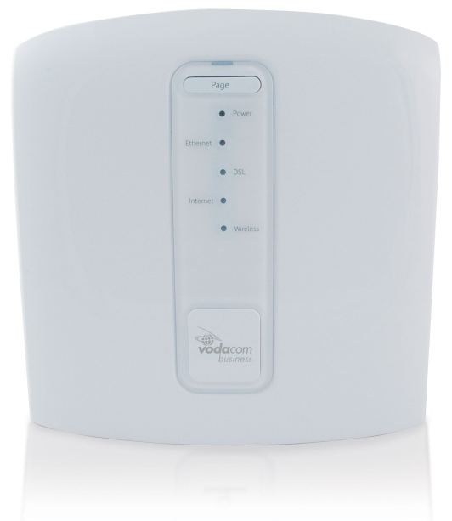
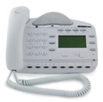

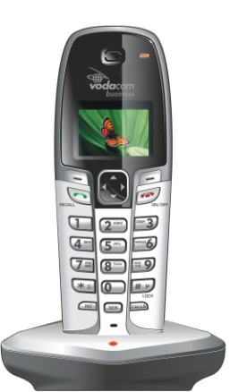
VB PBX
Components
VB Executive Phone
VB Office Phone
Vodacom Business PBX
VB Cordless Phone

Slide 18
Notes:
Our four main towers of services include:
Access Services
A state-of-the-art, carrier-class, next-generation network that offers both fixed and wireless access technologies ranging from 3G and HSDPA, WiMax, Microwave, ADSL, Leased Lines and Fibre.
Managed Hosted Services
Providing customers the ability to outsource functions such as hosting, application services, storage and security functions which will be housed in our specialised, robust and fully redundant data centre
Managed Network Services
These include a range of Internet service provider solutions, virtual private network (VPN) solutions and a next-generation network that will provide communication options including traditional mobile voice and Internet based voice solutions.
Converged Application Services
Enabling customers to access any communication service or application via a range of devices, from anywhere offering true convergence.

Slide 19

Broadband Data
and the value it brings

Slide 20
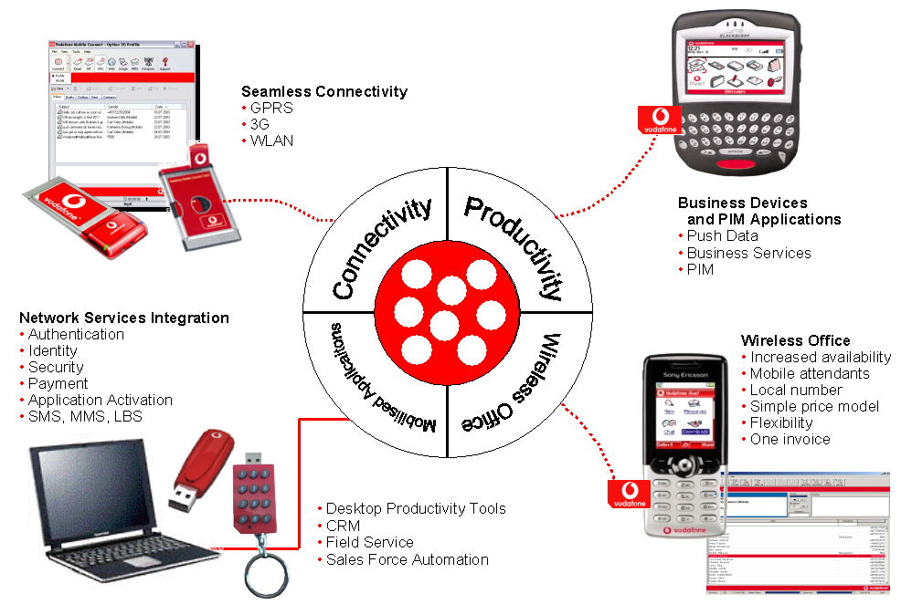
CREATING EFFICIENCY
3
1
5
2
4

Slide 21
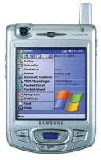




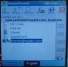





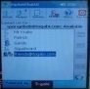
Multi-Player Gaming
Gaming
Wireless
Community
Interactive
& High Resolution Video
Games
UMTS
Access
Player 1
Higher Bandwidth
Lower Latency in Downlink
Gaming
Server
GGSN
UMTS Access
Player 2
Notes:
Proof of functionality – can be productized with acceptable performance and QoE assurance
Use case scenarios - scripts
Family plan $20 / device for unlimited P2C.
Spouse 1 selects Spouse 2 and presses the P2C button to initiate call. When call is underway, "Hi how are you ?" and after the usual courtesy between spouses…"I just arrived in Atlanta and I am having a great time at CTIA 2004 and wanted to show you this place is abuzz with activity" Show user 2 a short live video of the show floor. Spouse 2 "I am glad things are going good - and hope you can conclude the big contract. But before you go…Matthew wants to say hi to you…" Turns the camera to the infant in the play pen.
Enterprise plan (integrated with vertical applications such as MLS queries and forwarding MLS listing of interest) $50 /device for unlimited P2C, MLS query and forwarding.
Real estate agent shares the video of a property to interested buyers. (Buyers are given the device and service as part of signing up with real estate company - a competitive differentiator). This can be either a broadcast or a one-to-one call. Real estate agent can set up appointments to view the property or make offers on the same call. Increases efficiency, saves time and money for both buyers and agent, avoids wasteful trips to properties that are not of interest. Satisfied customers - with real time access to their agent.
Competitive differentiator and new source of revenue

Slide 22
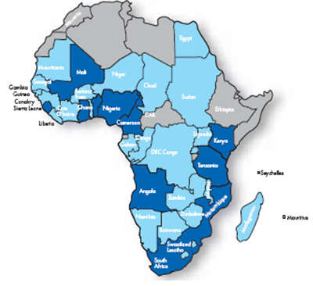
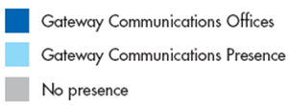
Expansion into Africa
Gateway Communications
Lead the drive to light up the
continent and to deliver Pan
African voice and data services

Slide 23
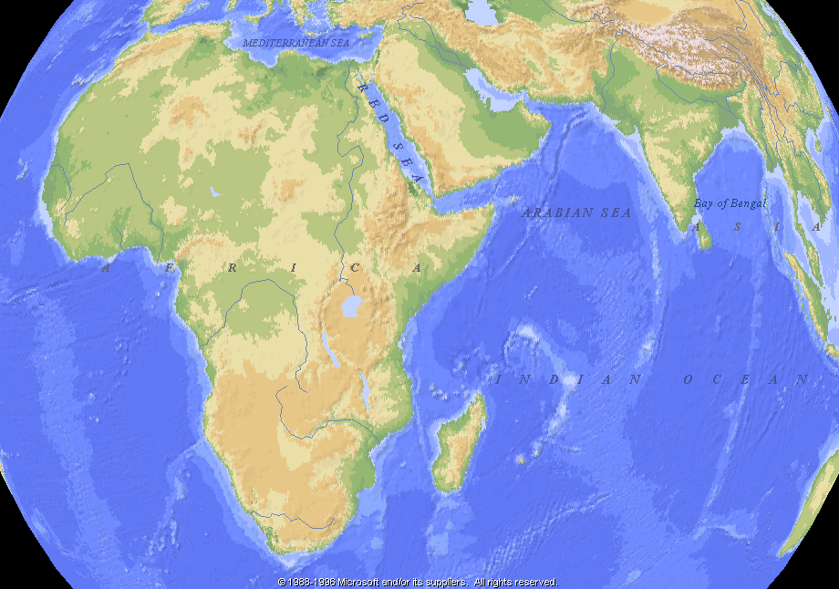
1
2
3
26
4
25
SEA ME WE 3
16
6
7
8
2324
17
5
9
23
10
22
21
11
SAT-3/WASC
15
18
14
13
12
SAFE
Notes:
Relationships with Global crossing in uk and washington

Slide 24

The Future?

Slide 25
Several access technologies will co-exist
There is a difference in bandwidth
NGOA
Wireline
(Fiber)
160
140
120
GPON
DSM L3
Wireline
(Copper)
100
User Data Rate (Mbps)
80
60
VDSL2
40
BPON
LTE;
WiMAX
Wireless
ADSL2+
20
ADSL
VDSL
ADSL2
WiMAX
0
HSPA evo
UMTS
HSPA
2000
2002
2004
2006
2008
2010
In case of shared media (PON, wireless) the assumed user data rate corresponds to commercial offers per subscriber

Slide 26
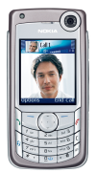





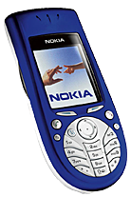






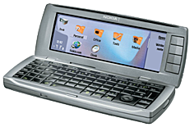
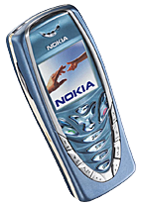
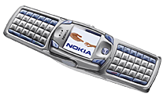


Service Evolution opens a Large Number of Compelling and Richer Services
Person-to-person services
Content-to-person
services
Video sharing
Video calling
Push to talk
Video messaging
Business
services
Photo and audio messaging
Full Internet
browsing experience,
high-value videos and TV
Enhanced
browsing,
versatile
applications
Short
videos
Improved performance
and usability,
Mobile meetings
Basic
applications
Basic
browsing,
rich terminal
personalization
Messaging and mobile e-mail
Secure corporate connectivity
Notes:
Justify the price
Fight against the competition
Identify case specific advantages
Establish strong partnership
Enhance the partnership
http://www.kotlermarketing.com/services/value-based.html
Philip Kotler is the S.C. Johnson & Son Distinguished Professor of International Marketing at the Northwestern University Kellogg Graduate School of Management in Chicago. He is hailed by Management Centre Europe as "the world's foremost expert on the strategic practice of marketing." He has authored what is widely recognized as the most authoritative textbook on marketing: Marketing Management, now in it's 12th edition. He has also authored, or co-authored a number of other leading books, including Kotler on Marketing; Lateral Marketing; Strategic Marketing for Non-Profits; Marketing for Healthcare Organizations; Marketing Professional Services; Marketing From A to Z; The 10 Deadly Marketing Sins; Marketing Moves; Marketing places; the Marketing of Nations; and Social Marketing.
In addition, he has published more than one hundred articles in leading journals, including the Harvard Business Review, Sloan management Review, Business Horizons, California Management Review, and the Journal of Marketing. Phil holds many major awards, including the Distinguished Marketing Educator of the Year Award of the American Marketing Association and Marketer of the Year by the Sales and Marketing Executives International (SMEI)
Phil has consulted to many major U.S. and foreign companies - including IBM, Michelin, Bank of America, Merck, General Electric, Honeywell, and Motorola - in the areas of marketing strategy and planning, marketing organization, and international marketing.
He presents continuing seminars on leading marketing concepts and developments to companies and organizations in the U.S., Europe and Asia, and participates in KMG client projects.

Slide 27
Today?

Slide 28
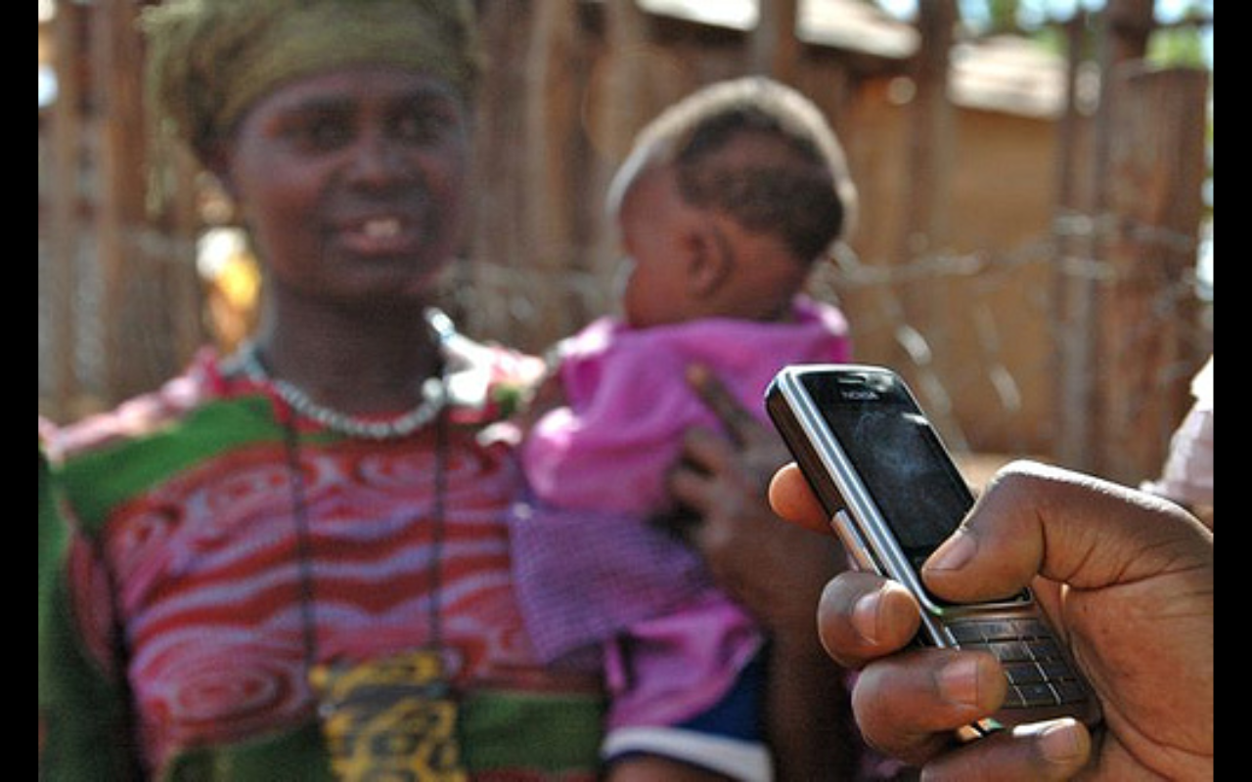
eHealth and mHealth
• Defining mHealth vs eHealth
Mobile phones to revolutionise health
care in developing countries
More accessible than computers and far
more cost-effective than hospital beds
64% of all mobile users are in the
developing world
Infrastructure and capacity a mere
commodity
“Ultimately, the take up of mobile communications in the health sector isn’t about technology at all”-Greg Elphinston, Director Community Involvement, Nokia

Slide 29

E-Health :ICT for Health
ELECTRONIC
HEALTH
RECORD
DEASES MANAGEMENT SYSTEMS
HEALTH BUSINESS INTELLIGENCE
TELEMEDICINE
E-PRESCIPTION
E-LEARNING AND THE INTERNET
LEGAL, ETHICS AND CONFIDENTIALITY FRAMEWORKS
HEALTH INFORMATION TECHNOLOGY PLATFORMS
ICT INFRASTRUCTURE

Slide 30
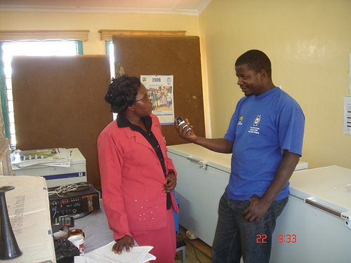
Impact of mHealth
“ A 2007 pilot in South Africa showed that
with SIMpill, 90% of patients complied
with their medication regime, compared
with the typical 22% to 60% compliance
rate without the system.”
Project Masiluleke-365m text messages
to encourage people to be tested
Smile for you campaign
Source: E-Health Insider, Technology Review, Vodafone Policy Paper Series

Slide 31
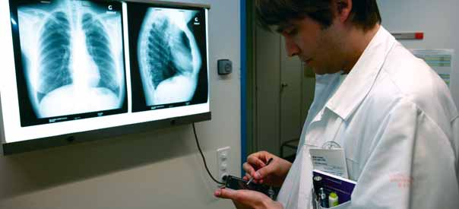
E-Health
PDA use in the Eastern Cape

Slide 32
Value proposition
Not constrained by legacy infrastructure
Converged team approach – “first in the
world”
Pricing – “ticket to the game”
Service delivery and Convergence to be
driven by mobile handsets
Use wireless strategy to “connect”
service delivery
Notes:
32

Slide 33


TIMING
First run of the new booklets will be in store by 7 August
Going forward all new deal booklets to be sent out with
every new deal period
Updated re-printed deal booklets to be sent out on the
second month of every deal period
THANK YOU
33

